Slide 1
Introduction to SAS

Slide 2
SAS, short for Statistical Analysis System, is a packaged computer program that aids us in the statistical analysis of data.
The SAS program has very many options and features, which make it an extremely powerful tool.
The input to SAS is called a program and, most of the time, it can be divided into three parts.
The first part is a description of the data that the program is to analyze.
The second part is the data itself, that is to be analyzed.
The first and second parts together are termed the DATA step
The third part is the list of instructions describing what SAS should do.
Each type of analysis that SAS can do is called a PROCEDURE

Slide 3
DATA Step
SAS program
Procedure

Slide 4
A Simple Example
Line # Contents of line
<1> DATA;
<2> INPUT A B;
<3> CARDS;
<4> 6 2
<5> 7 4
<6> 5 6
<7> PROC PRINT;
<8> PROC MEANS;
The above is a simple example of a SAS program using a data set consisting of 3 values for each of 2 variables. The data are first input, then printed out and, finally, the means, standard deviations, and some other statistics of the variables are computed and printed out.
A description of each line follows.

Slide 5
Line # <1>
DATA;
This statement indicates the beginning of the data step. Here we do not intend to give the data set we are working with a name since none is given.
All procedures (PROCs) will automatically refer to this unnamed (default) data set unless specifically instructed otherwise.

Slide 6
Line # <2>
INPUT A B;
This statement identifies the names of the variables that will be assigned values when the data are input.

Slide 7
Line # <3>
CARDS;
This statement indicates that the values to be input come from the data line (punched cards) following it.

Slide 8
Line # <4> ~ <6>
6 2
7 4
5 6
These are the data values to be analyzed. The numbers 6, 7 and 5 are assigned to the variable A while 2, 4 and 6 are assigned to the variable B

Slide 9
Data Step:
DATA ;
INPUT A B;
CARDS;
6 2
7 4
5 6
SAS data set
work.data1
A B
6
2
7
4
5
6

Slide 10
Line # <7>
PROC PRINT;
This statement prints the values of each of the variables.

Slide 11
Line # <8>
PROC MEANS;
This statement calculates and prints out the mean, standard deviation, and some other statistics of each of the variables.

Slide 12
How to run a SAS program

Slide 13

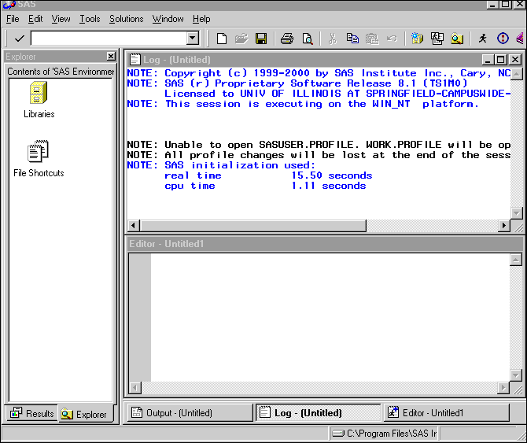
How to run a SAS program - SAS/PC
Double click the SAS icon:
Your screen should change as:

Slide 14
How to run a SAS program - SAS/PC
You can type your SAS program in “Editor” area:

Slide 15
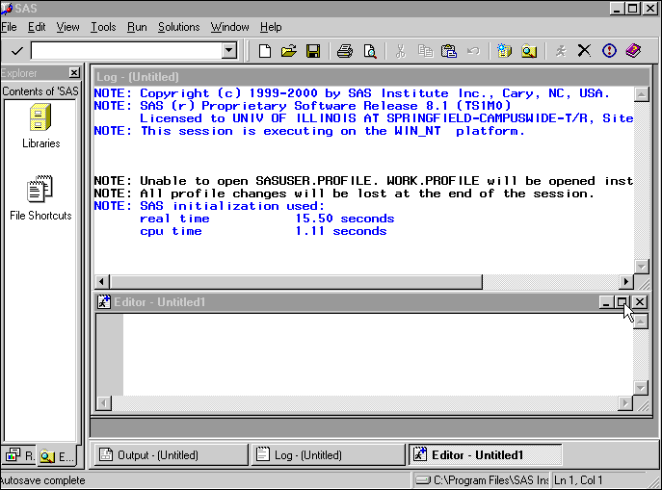
How to run a SAS program SAS/PC

Slide 16
How to run a SAS program SAS/PC
After you finish editing the SAS program, you are ready to “run” the program.
To submit the SAS program, click the “Submit” button
which locates at the top panel.

Slide 17
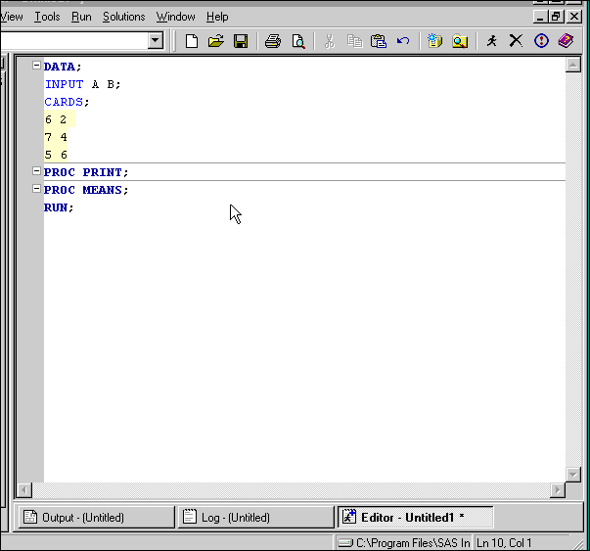
How to run a SAS program SAS/PC

Slide 18
How to run a SAS program SAS/PC
After the program is submitted and there is no major error (program error), the output (result) of the last PROCEDURE will be shown on the screen.
To view the outputs (results) of other PROCEDUREs, click the button on the PROCEDURE’s name which is located on the left panel on the screen.
The followings are the output of PRINT procedure and MEANS procedure.

Slide 19
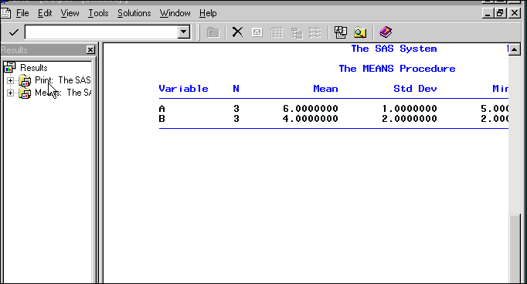
How to run a SAS program SAS/PC
Output of SAS PRINT procedure

Slide 20
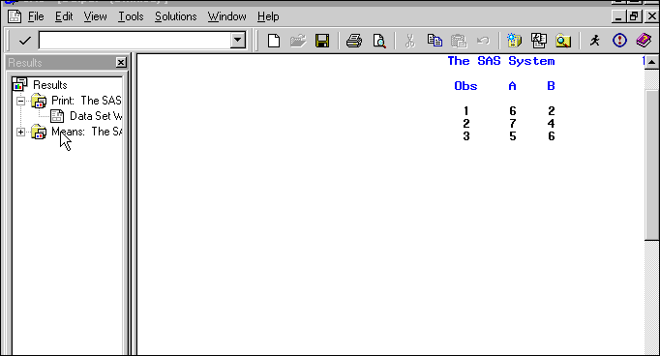
How to run a SAS program SAS/PC
Output of SAS MEANS procedure

Slide 21
How to run a SAS program SAS/PC
In addition to the output files, SAS also produces LOG file.
SAS LOG file is used to provide the information of SAS performance and also provide the error messages if there are program syntax errors.
Always checks your SAS LOG file, after you submit a SAS program.
Here is the LOG file generated by the SAS program we just submit.

Slide 22
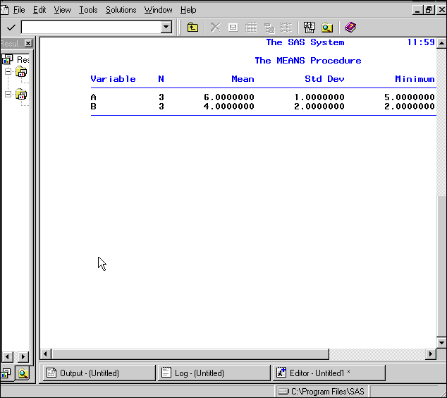
How to run a SAS program SAS/PC

Slide 23
How to run a SAS program SAS/PC
If we have program syntax error, most of them we will be able to find from the SAS LOG file.
The following is a demonstration what will happen to SAS LOG file when a SAS program with several syntax errors is submitted.

Slide 24
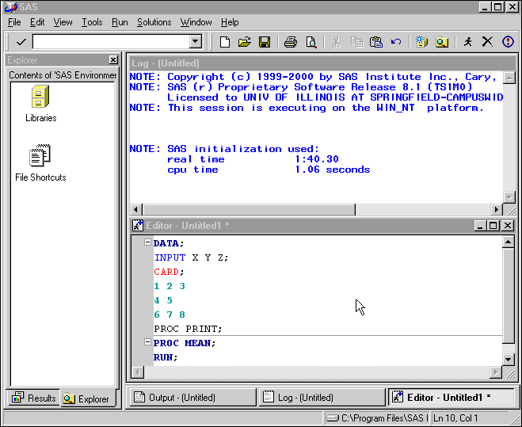
How to run a SAS program SAS/PC

Slide 25
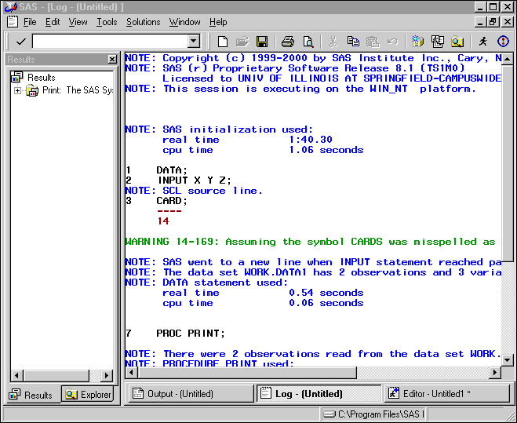
How to run a SAS program SAS/PC

Slide 26
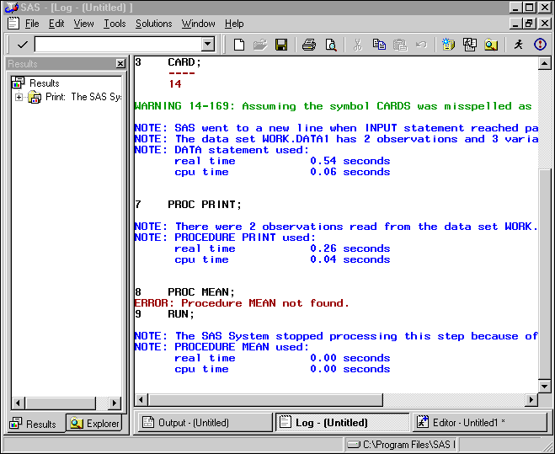
How to run a SAS program SAS/PC

Slide 27
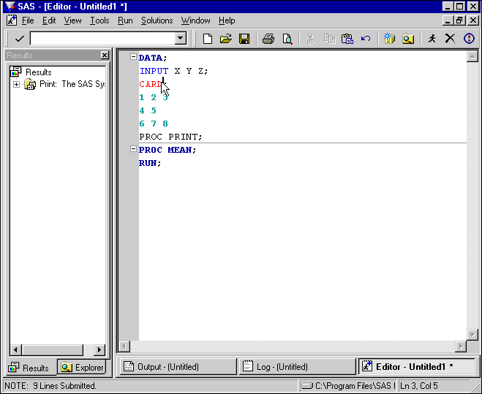
How to run a SAS program SAS/PC

